Slide 1
SALES AND REVENUE DASHBOARD

Slide 2
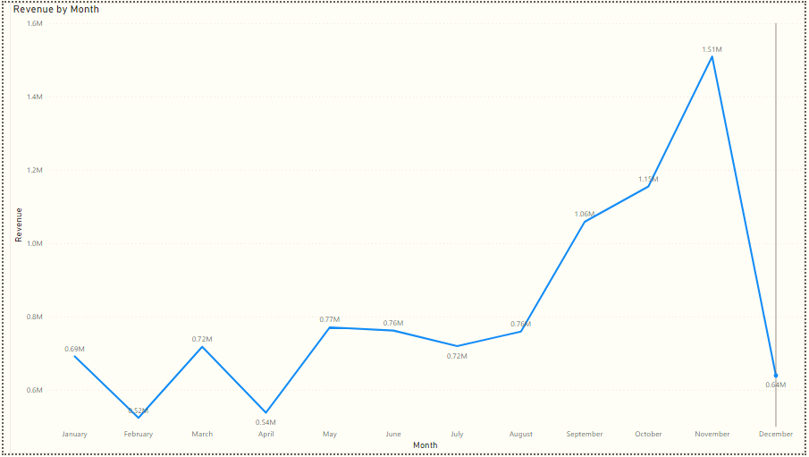
Project analysis slide 2
Seasonal
Patterns
The first eight months, from January to August, consistently generated an average monthly revenue of $685,000. However, in September, the revenue experienced a notable increase of 40% compared to the previous month. This upward trend continued until November, reaching a peak of $1 million, the highest amount recorded throughout the year

Slide 3
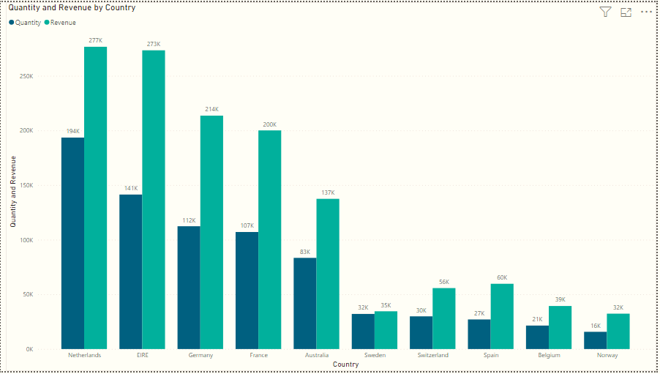
Project analysis slide 2
Countries
Growth
As the UK already has a significant demand and considering your preference for countries where demand can be further increased, the UK is not included in these statistics. Based on the data, nations such as the Netherlands, Ireland, Germany, and France exhibit high sales of units and income. To effectively capitalize on these markets, I recommend focusing on these countries.

Slide 4
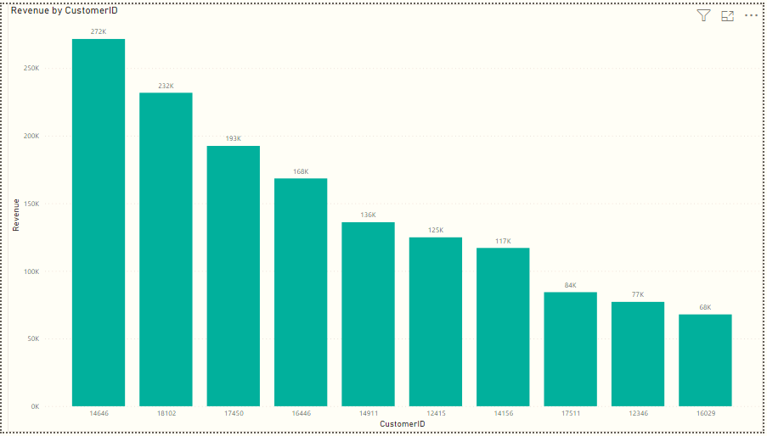
Project analysis slide 2
Revenue
Over Customer
The statistics indicate that there are minimal variations in the purchasing patterns among these top 10 consumers. Interestingly, the consumer with the highest revenue contribution spent only 17% more than the second highest consumer. This suggests that the company's income generation is not heavily dependent on a small group of customers. It also implies that customers' negotiation power is limited, and overall business conditions are favorable.

Slide 5
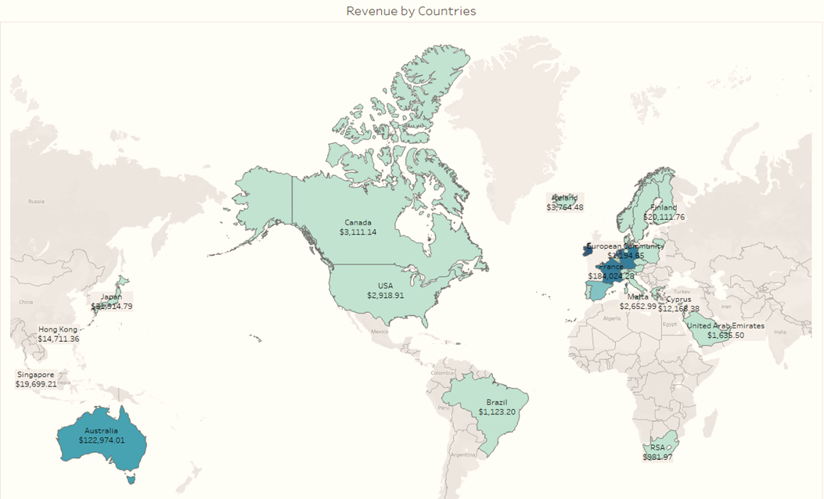
Project analysis slide 2
Revenue
Over Customer
The map highlights that majority of sales occur within the European zone, with only a limited number in the American region. There is no market for the company's products in Africa or Asia, including Russia. Implementing a new strategy that focuses on these regions may lead to higher sales revenues and profitability.

Slide 6
Thank You

